Slide 2
Differentiation
the process by which differences between learners are accommodated so that all students in a group have the best possible chance of learning’

Slide 4
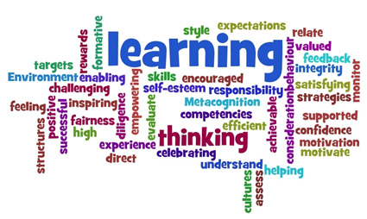
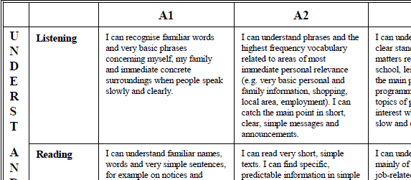
Consideration from the teacher‘s perspective
learning styles
skill levels
background experiences and knowledge
physical needs

Slide 5
Categories.
Task
Grouping
Pace
Outcome
Assessment

Slide 6
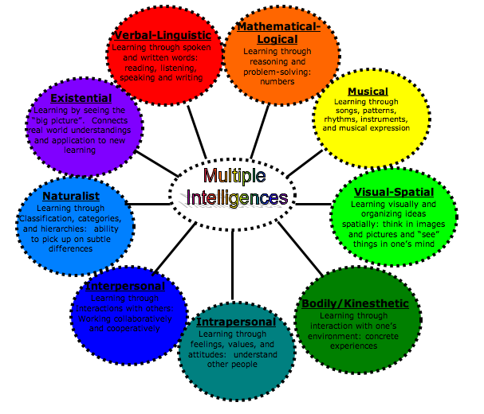
Task
According to learning styles
Based on Multiple Intelligences by Howard Gardner

Slide 7
Inner – outer circle
Inner circle
For everybody
Outer circle
Three or more options accordding their MI Profile
Each individual possesses all of the
intelligences, but they are not all present in
equal proportions.

Slide 8
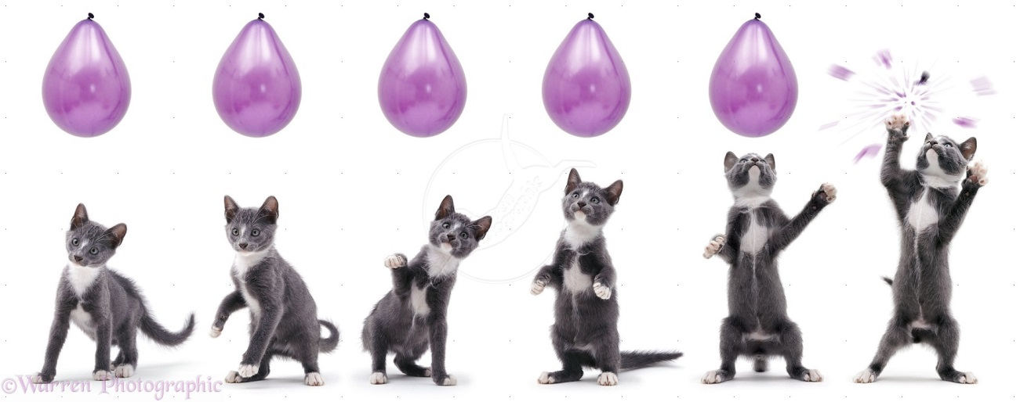
Mathematical logical
structure
catagorize
Learn step by step (sequencial)
Try to understand what you‘re learning (why?)
Group the information

Slide 9
Linguistic
Repeat using your own words
Think of a different
headline
Find a slogan
Find a rhyme
Take notes
Discuss what you‘ve learned

Slide 10
kinaesthetic
Take notes
match (matching ercises)
Underline, highlight,
cut
Use index cards
Walk around while learning

Slide 11
Musical
Speak rhythmically
Snap your fingers while reading
Use rap
Don‘t listen to music while learning
Read aloud and
repeat aloud

Slide 12
Intra-personal
Close your eyes and picture the lesson
Ask yourself what you liked about the lesson
Ask yourself what was new
Write your „diary“
Rearrange what you have to learn according to your likes

Slide 13
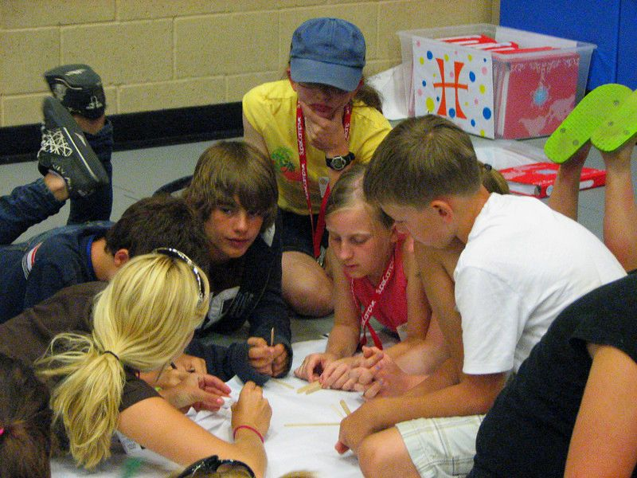
Inter-personal
Pair work
Group work
Explain it

Slide 14
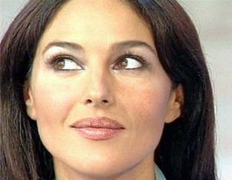
Visual - Spatial
Use colours
Underline, highlight
Picture the information with your inner eye
Use mind maps

Slide 15
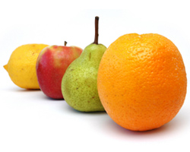
Naturalistic
Categorize according to special features
Find differences and things that are in common
Sequence the information
Go for a walk and reflect what you‘ve learned

Slide 16
Existential
How might this information be important for me?
What might a person having lived a 100 years ago have thought about it?
How could that information influence the world / my environment?

Slide 18
Grouping
develop collaborative and co-operative skills
have the opportunity to learn from and to teach each other
The focus is on student centred approach
Quiet students have an opportunity to speak and be heard in small groups

Slide 19
Pace
Quick students are not held back
Slow students can take their time to do their tasks

Slide 20
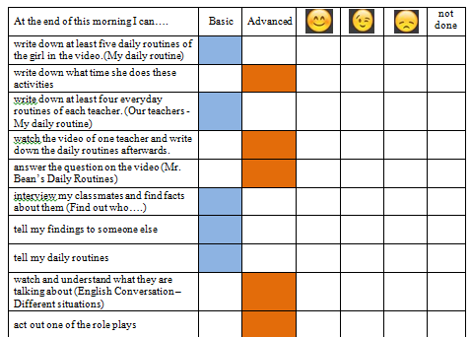
Outcome
I can do
statements

Slide 21
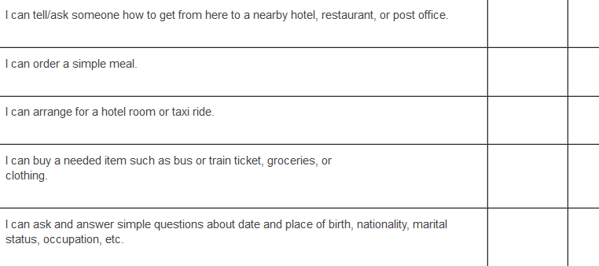
Assessment
students are assessed on an on-going basisrather than assessment taking place at the end of learning,

